Slide 1
Geocoding project.
Conversation about positioning history geocoding to improve pin-point accuracy.
Learn something new to stay away from alzheimer

Slide 2
Use case
Ride hailing, food delivery, & shipping.
If user only put pin point using suggested address at first , we don’t know the relative location/specific location where user want to meet with the driver.
create cluster of latlong each [pin-point]
previous meeting point + message/conversation
suggest to driver based on chat/message positioning similarity [cluster centroid]
get similarity [tfidf cosine distance] of current message from previous message history.

Slide 3
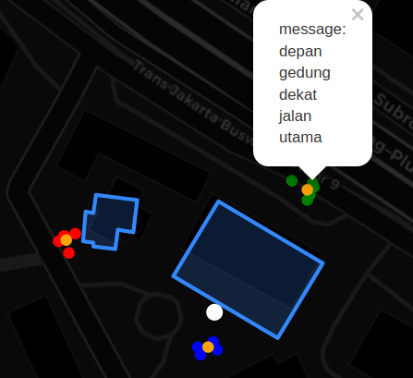
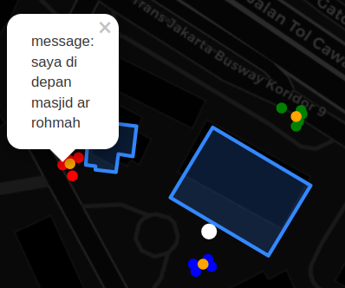
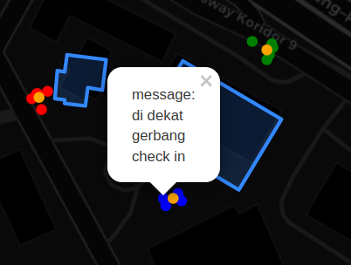
Mock Cases/Simulation (Wisma Mulia)
near mosque pickup history
Centroid from KMeans clustering of latlong from same pin point
near checkpoint gate
Pin point (Wisma Mulia)
in front of building (north)

Slide 4
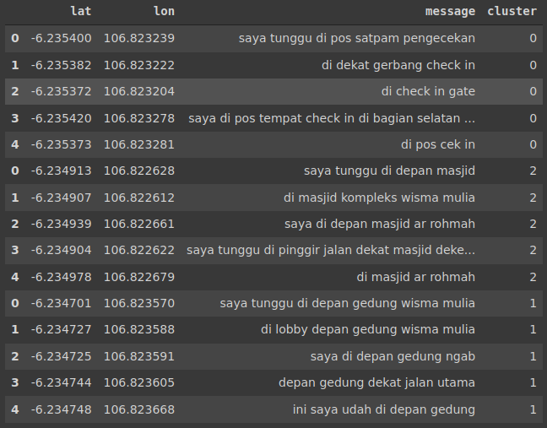
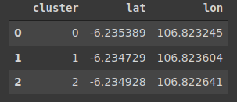

Information used & generated
message history and their meetup location
cluster centroid
tfidf string similarity as confidence check, return a cluster [get its centroid as latlong suggestion].

Slide 5
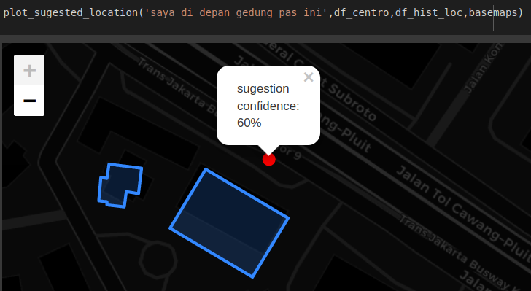
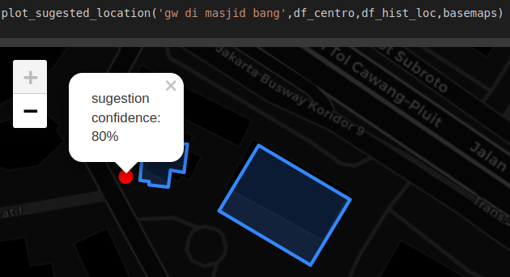
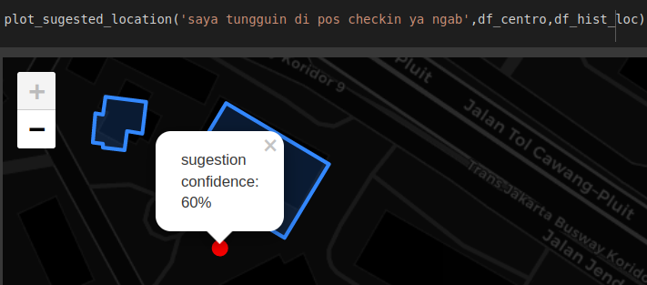
Test simulation

Slide 6
Question:
How to know which conversation linked as positioning conversation?
Answer:
Actually, we need NLP task to classify message first using some terminology/words in positioning (eg: in front of mosque,north of building, etc.), then continue to validation step.
How to know that a conversation positioning is valid?
Answer:
To make sure meeting position we can measure user and driver closest distance point location as meeting point (if user meet with driver after messaging each other and there was a conversation about positioning we can assume is as valid positioning conversation). Another conversation with same pin-point will enrich cluster quality and enrich positioning message for each cluster (giving more data will improve valid proba).

